Slide 1
HR Analytics Dashboard
Tableau Project
By Aishwarya

Slide 2

This project enables smarter HR decisions by providing deep insights into organization's attrition rate.
OBJECTIVE

Slide 3
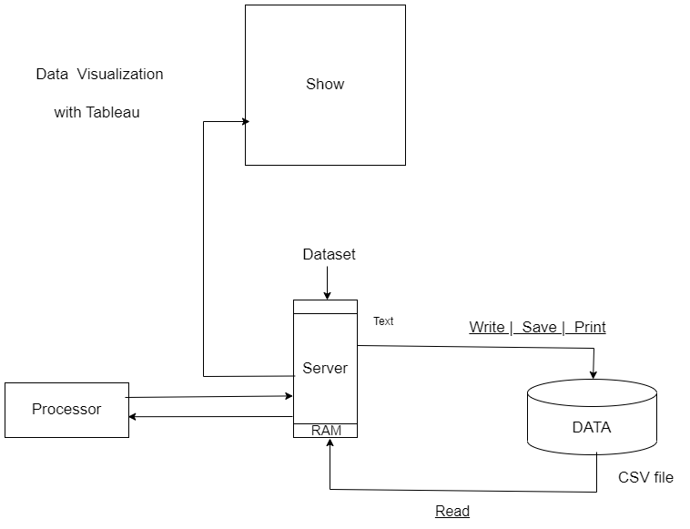

Slide 4
SUMMARY
Data Acquisition: we sourced a comprehensive data set in CSV format and imported it into Tableau, establishing a solid foundation for analysis.
Data Cleaning and Transformation: With meticulous attention to detail, we performed rigorous data cleaning using Power Query Editor. This involved addressing errors, eliminating null values, and preparing the data for accurate analysis.

Slide 5

3. Enriching the Data: To uncover hidden patterns and correlations, we enriched the existing table by creating new columns, such as service year, job level, retrenchment status, and promotion status.
4. Advanced Analysis with DAX Language: Leveraging the power of the DAX language, we harnessed its capabilities to calculate key measurements critical to analysis. This included determining the total employee count, identifying employees due for promotion, evaluating employees not due for promotion, and identifying employees to be retrenched.
5. Visualizing Insights: To bring the data to life, we utilized the rich visualization capabilities of Tableau. The result is an intuitive dashboard that showcases essential key performance indicators (KPIs) such as total employee count, employees due for promotion, and employees to be retrenched.

Slide 6
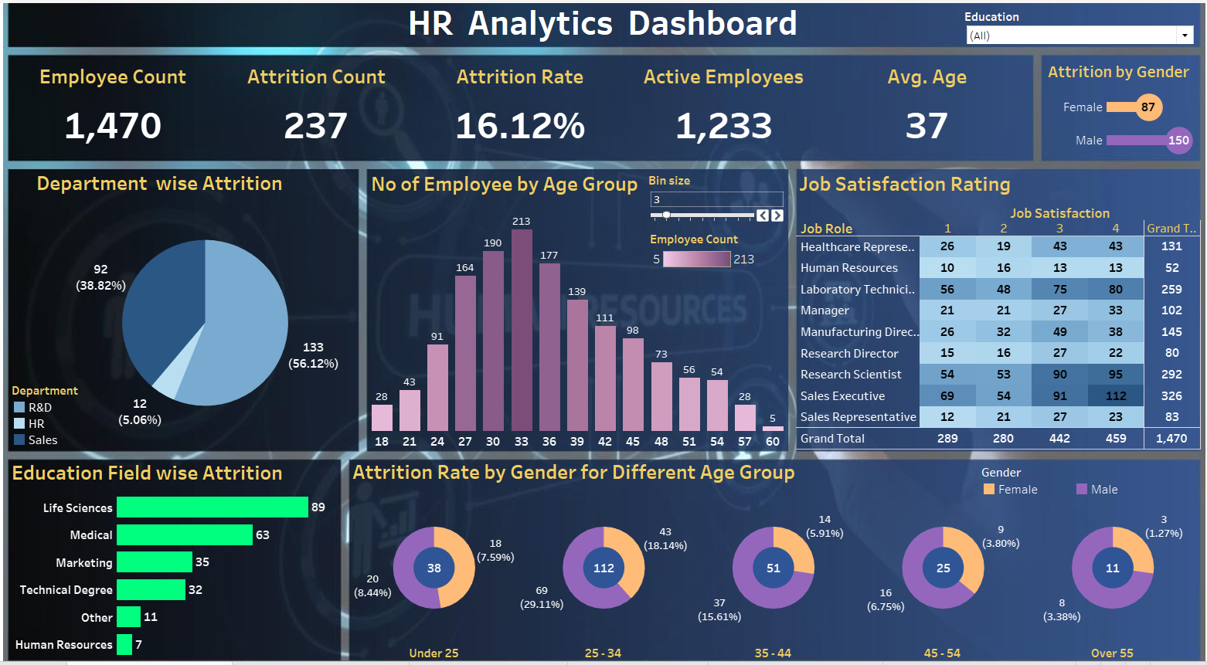

Slide 7

Complete project on Youtube:
Part 1- https://youtu.be/oAIubTqg-Kw
Part 2- https://youtu.be/oTyCZVnNVZA

Slide 8

Thank you

